Slide 1
CompTIA Security+ Guide to Network Security Fundamentals, Sixth Edition
Chapter 3
Basic Cryptography

Slide 2
Objectives
3.1 Define cryptography
3.2 Describe hash, symmetric, and asymmetric cryptographic algorithms
3.3 Explain different cryptographic attacks
3.4 List the various ways in which cryptography is used

Slide 3
Defining Cryptography
Defining cryptography involves:
Understanding what it is
Understanding what it can do
Understanding how cryptography can be used as a security tool to protect data

Slide 4
What is Cryptography? (1 of 7)
Cryptography
Scrambling information so it cannot be read
Transforms information into secure form so unauthorized persons cannot access it
Steganography
Hides the existence of data
An image, audio, or video file can contain hidden messages embedded in the file
Achieved by dividing data and hiding in unused portions of the file
May hide data in the file header fields that describe the file, between sections of the metadata (data used to describe the content or structure of the actual data)

Slide 5
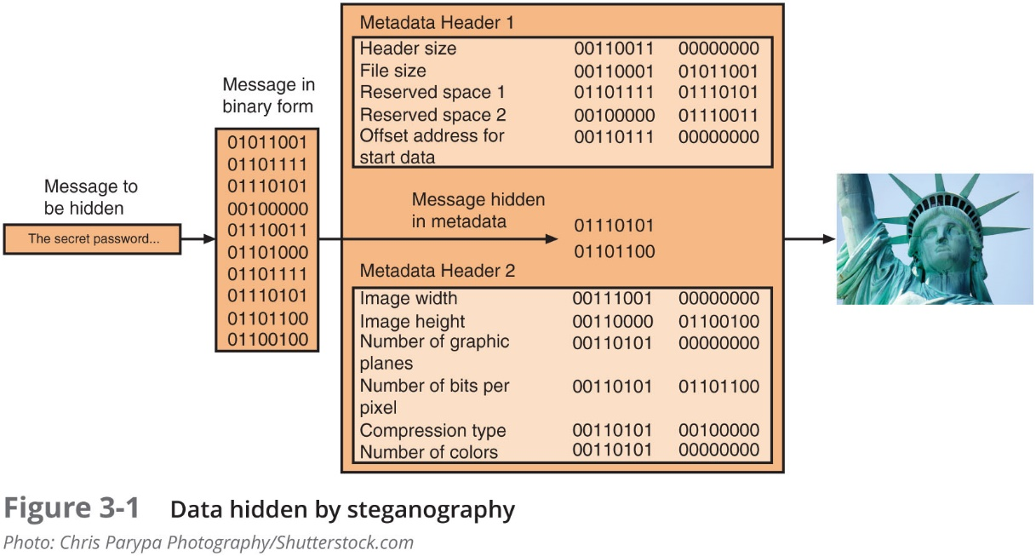
What is Cryptography? (2 of 7)

Slide 6
What is Cryptography? (3 of 7)
Encryption
Changing original text into a secret message using cryptography
Decryption
Changing secret message back to original form
Plaintext
Unencrypted data to be encrypted or is the output of decryption
Ciphertext
The scrambled and unreadable output of encryption
Cleartext data
Data stored or transmitted without encryption

Slide 7
What is Cryptography? (4 of 7)
Plaintext data is input into a cryptographic algorithm (also called a cipher)
Consists of procedures based on a mathematical formula used to encrypt and decrypt the data
Key
A mathematical value entered into the algorithm to produce ciphertext
The reverse process uses the key to decrypt the message
Substitution cipher
Substitutes one character for another
One type is a R O T13, in which the entire alphabet is rotated 13 steps (A = N)
XOR cipher
Based on the binary operation eXclusive OR that compares two bits

Slide 8
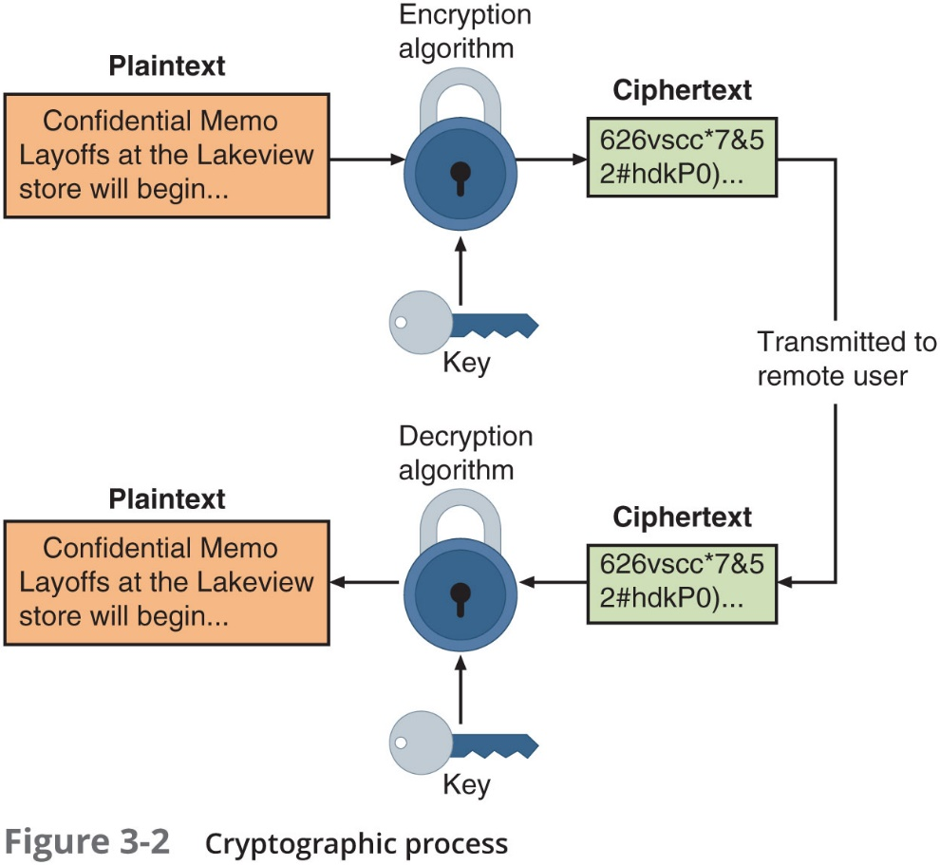
What is Cryptography? (5 of 7)

Slide 9
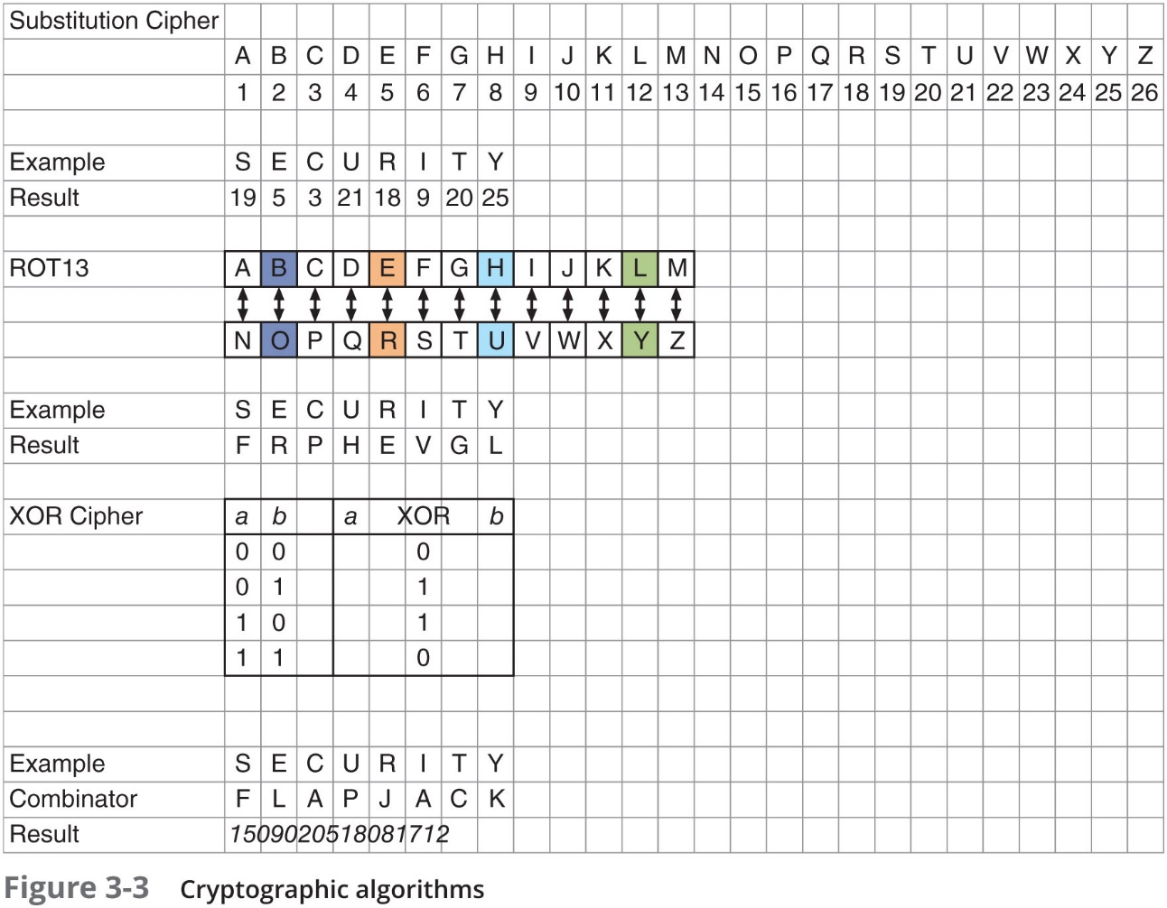
What is Cryptography? (6 of 7)

Slide 10
What is Cryptography? (7 of 7)
Modern cryptographic algorithms rely upon underlying mathematical formulas
Depend upon the quality of random numbers (no identifiable pattern or sequence)
Software relies upon a pseudorandom number generator (P R N G)
An algorithm for creating a sequence of numbers whose properties approximate those of a random number
Two factors that can thwart threat actors from discovering the underlying key to cryptographic algorithms:
Diffusion – if a single character of plaintext is changed then it should result in multiple characters of the ciphertext changing
Confusion – the key does not relate in a simple way to the ciphertext

Slide 11
Cryptography and Security (1 of 3)
Cryptography can provide five basic protections
Confidentiality
Ensures only authorized parties can view it
Integrity
Ensures information is correct and unaltered
Authentication
Ensures sender can be verified through cryptography
Non-repudiation
Proves that a user performed an action
Obfuscation
Making something obscure or unclear
Security through obscurity
An approach in security where virtually any system can be made secure as long as outsiders are unaware of it or how it functions

Slide 12
Cryptography and Security (2 of 3)
Characteristic | Description | Protection
Confidentiality | Ensures that only authorized parties can view the information | Encrypted information can only be viewed by those who have been provided the key
Integrity | Ensures that the information is correct and no unauthorized person or malicious software has altered that data | Encrypted information cannot be changed except by authorized users who have the key
Authentication | Provides proof of the genuineness of the user | Proof that the sender was legitimate and not an imposter can be obtained
Non-repudiation | Proves that a user performed an action | Individuals are prevented from fraudulently denying that they were involved in a transaction
Obfuscation | Makes something obscure or unclear | By hiding the details the original cannot be determined

Slide 13
Cryptography and Security (3 of 3)
Cryptography can provide protection to data as that data resides in any of three states:
Data in-use – data actions being performed by “endpoint devices”
Data in-transit – actions that transmit the data across a network
Data at-rest – data this is stored on electronic media

Slide 14
Cryptography Constraints (1 of 2)
The number of small electronic devices (low-power devices) has grown significantly
These devices need to be protected from threat actors
Applications that require extremely fast response times also face cryptography limitations
Resource vs. security constraint
A limitation in providing strong cryptography due to the tug-of-war between available resources (time and energy) and the security provided by cryptography
It is important that there be high resiliency in cryptography
The ability to quickly recover from these resource vs. security constraints

Slide 15
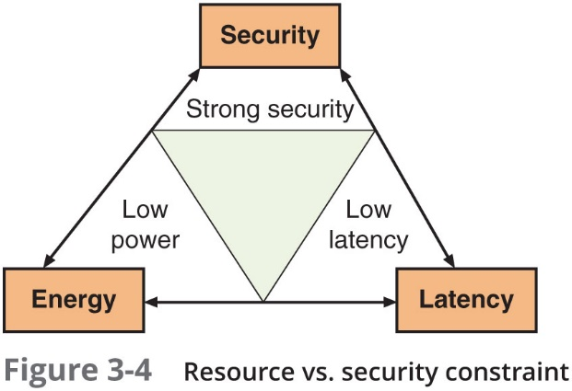
Cryptography Constraints (2 of 2)

Slide 16
Cryptographic Algorithms
A fundamental difference in cryptographic algorithms is the amount of data processed at a time
Stream cipher - takes one character and replaces it with another
Block cipher - manipulates an entire block of plaintext at one time
Sponge function - takes as input a string of any length and returns a string of any requested variable length
Three categories of cryptographic algorithms
Hash algorithms
Symmetric cryptographic algorithms
Asymmetric cryptographic algorithms

Slide 17
Hash Algorithms (1 of 5)
Hash algorithms
Creates a unique “digital fingerprint” of a set of data and is commonly called hashing
This fingerprint, called a digest (sometimes called a message digest or hash), represents the contents
Its contents cannot be used to reveal original data set
Is primarily used for comparison purposes
Hashing is intended to be one way in that its digest cannot be reversed to reveal the original set of data

Slide 18
Hash Algorithms (2 of 5)
Secure hashing algorithm characteristics:
Fixed size
Short and long data sets have the same size hash
Unique
Two different data sets cannot produce the same hash
Original
Data set cannot be created to have a predefined hash
Secure
Resulting hash cannot be reversed to determine original plaintext

Slide 19
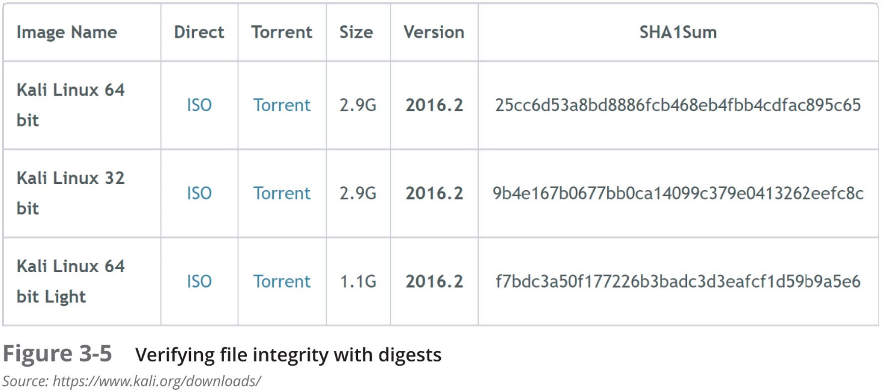
Hash Algorithms (3 of 5)
Hashing is often used as a check to verify that the original contents of an item has not been changed

Slide 20
Hash Algorithms (4 of 5)
Message Digest 5 (M D5)
Most well-known of the M D hash algorithms
Message length padded to 512 bits
Weaknesses in compression function could lead to collisions
Some security experts recommend using a more secure hash algorithm
Secure Hash Algorithm (S H A)
More secure than M D
S H A-2 is currently considered to be a secure hash
S H A-3 was announced as a new standard in 2015 and may be suitable for low-power devices

Slide 21
Hash Algorithms (5 of 5)
Race Integrity Primitives Evaluation Message Digest (R I P E M D)
The primary design feature is two different and independent parallel chains of computation
The results are combined at end of process
Several version of R I P E M D
R I P E M D -128, R I P E M D -256, and R I P E M D -320
Hashed Message Authentication Code (H M A C)
A hash variation providing improved security
Uses a “shared secret key” possessed by sender and receiver
Receiver uses a key to decrypt the hash

Slide 22
Symmetric Cryptographic Algorithms (1 of 5)
Symmetric cryptographic algorithms - use the same single key to encrypt and decrypt a document
Original cryptographic algorithms were symmetric
Also called private key cryptography (the key is kept private between sender and receiver)
Common algorithms include:
Data Encryption Standard
Triple Data Encryption Standard
Advanced Encryption Standard
Several other algorithms

Slide 23
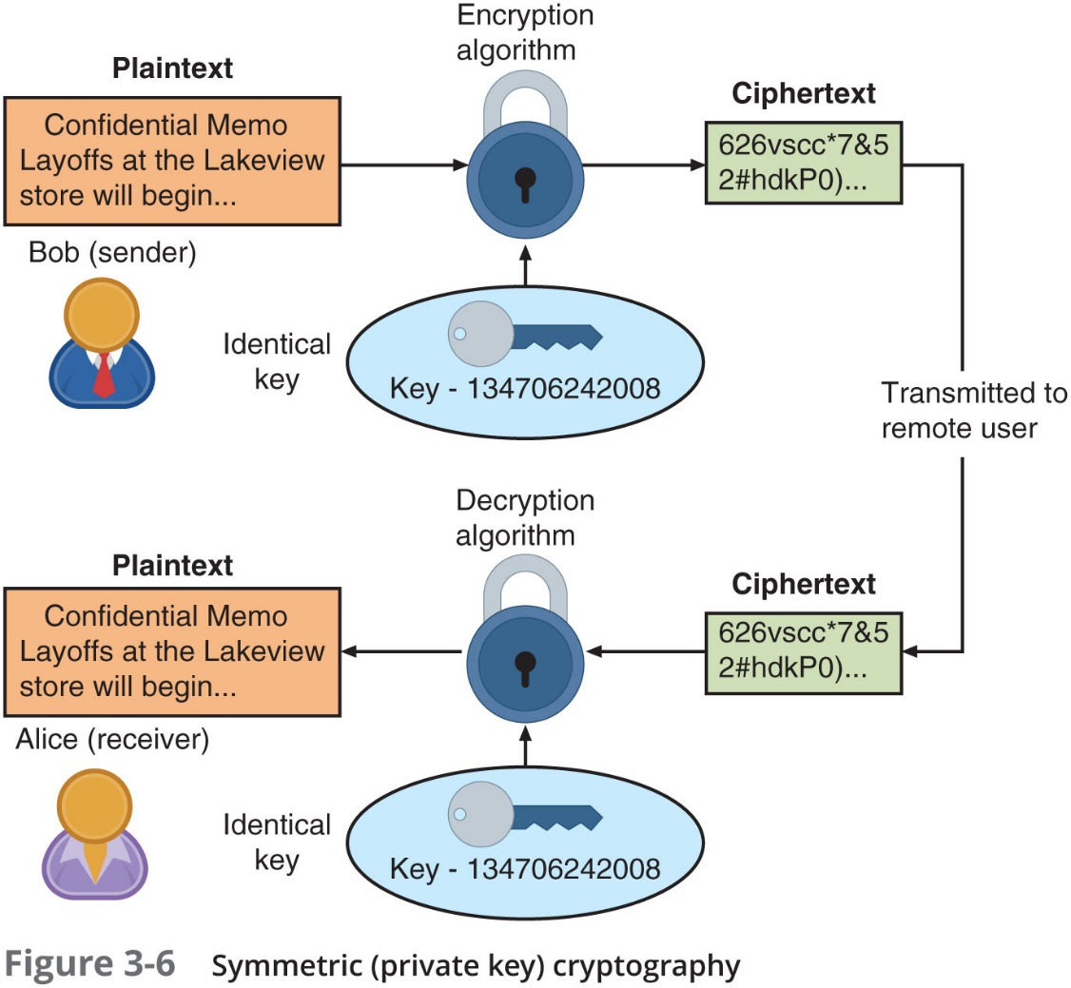
Symmetric Cryptographic Algorithms (2 of 5)

Slide 24
Symmetric Cryptographic Algorithms (3 of 5)
Data Encryption Standard (D E S)
Based on product originally designed in early 1970s
Uses a 56-bit key and is a block cipher
Triple Data Encryption standard (3 D E S)
Designed to replace D E S
Uses three rounds of encryption
Ciphertext of first round becomes input for second iteration
Most secure versions use different keys used for each round

Slide 25
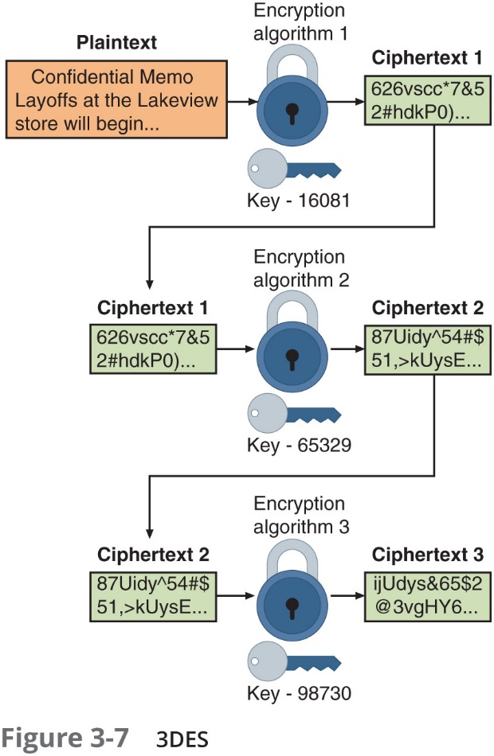
Symmetric Cryptographic Algorithms (4 of 5)

Slide 26
Symmetric Cryptographic Algorithms (5 of 5)
Advanced Encryption Standard (A E S)
A symmetric cipher approved by the N I S T in 2000 as a replacement for D E S
Performs three steps on every block (128 bits) of plaintext
Designed to be secure well into the future
Other Algorithms
Rivest Cipher (R C)
Family of cipher algorithms designed by Ron Rivest
Blowfish
Block cipher operating on 64-bit blocks with key lengths from 32-448 bits
No significant weaknesses have been identified
International Data Encryption Algorithm (I D E A)
Used in European nations
Block cipher processing 64 bits with a 128-bit key with 8 rounds

Slide 27
Asymmetric Cryptographic Algorithms (1 of 8)
Weakness of symmetric algorithms
Distributing and maintaining a secure single key among multiple users distributed geographically
Asymmetric cryptographic algorithms
Also known as public key cryptography
Uses two mathematically related keys
Public key available to everyone and freely distributed
Private key known only to individual to whom it belongs

Slide 28
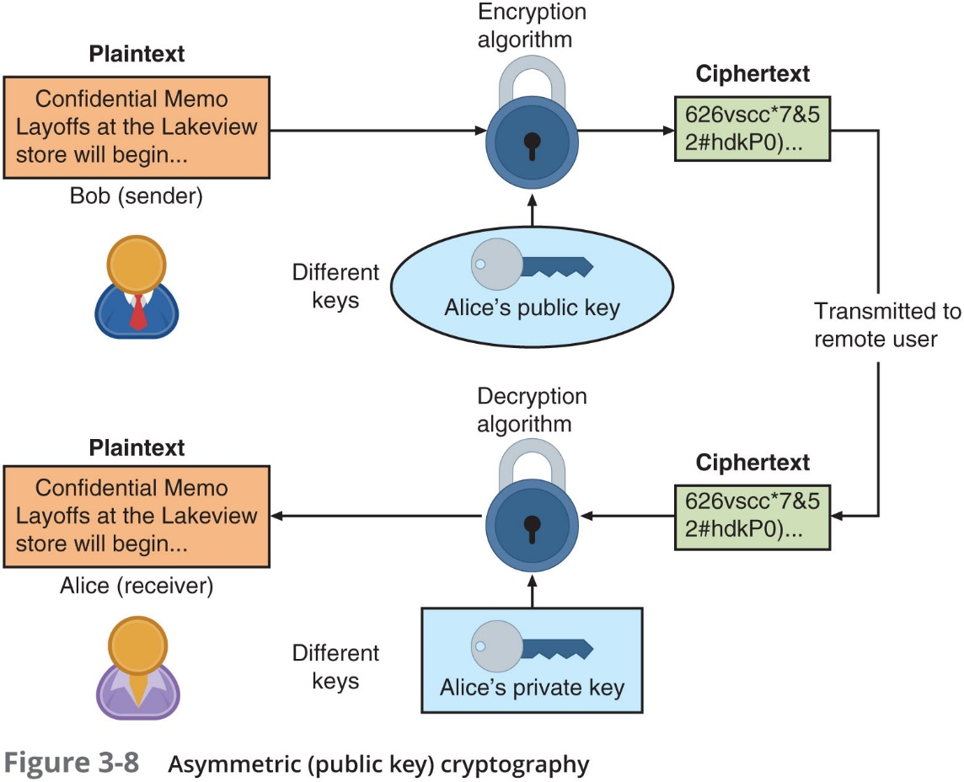
Asymmetric Cryptographic Algorithms (2 of 8)

Slide 29
Asymmetric Cryptographic Algorithms (3 of 8)
Important principles
Key pairs
Public key
Private key
Both directions - keys can work in both directions
Common asymmetric cryptographic algorithms:
R S A
Elliptic Curve Cryptography
Digital Signature Algorithm
Those relating to Key Exchange

Slide 30
Asymmetric Cryptographic Algorithms (4 of 8)
R S A
Published in 1977 and patented by M I T in 1983
Most common asymmetric cryptography algorithm
Uses two large prime numbers
Elliptic curve cryptography (E C C)
Users share one elliptic curve and one point on the curve
Uses less computing power than prime number-based asymmetric cryptography
Key sizes are smaller
Considered as an alternative for prime-number-based asymmetric cryptography for mobile and wireless devices

Slide 31
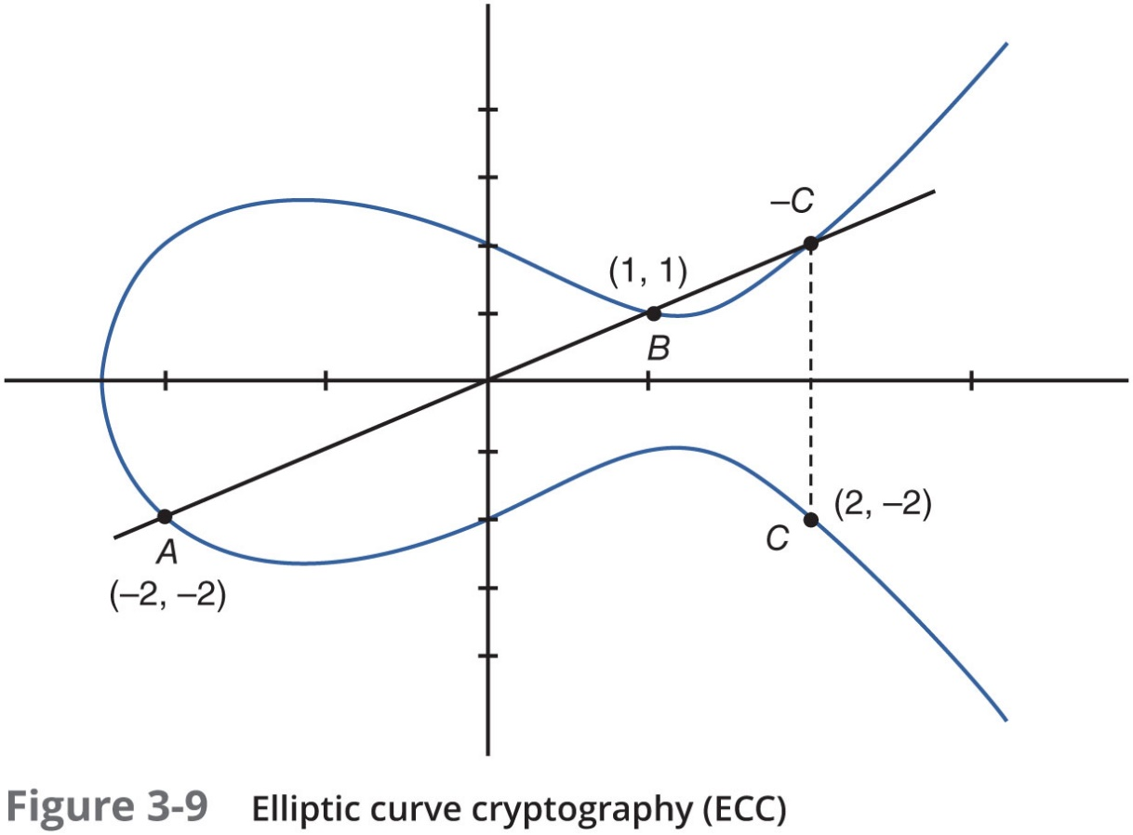
Asymmetric Cryptographic Algorithms (5 of 8)

Slide 32
Asymmetric Cryptographic Algorithms (6 of 8)
Digital Signature Algorithm (D S A)
Digital signature - an electronic verification
Verifies the sender
Prevents sender from disowning the message
Proves message integrity

Slide 33
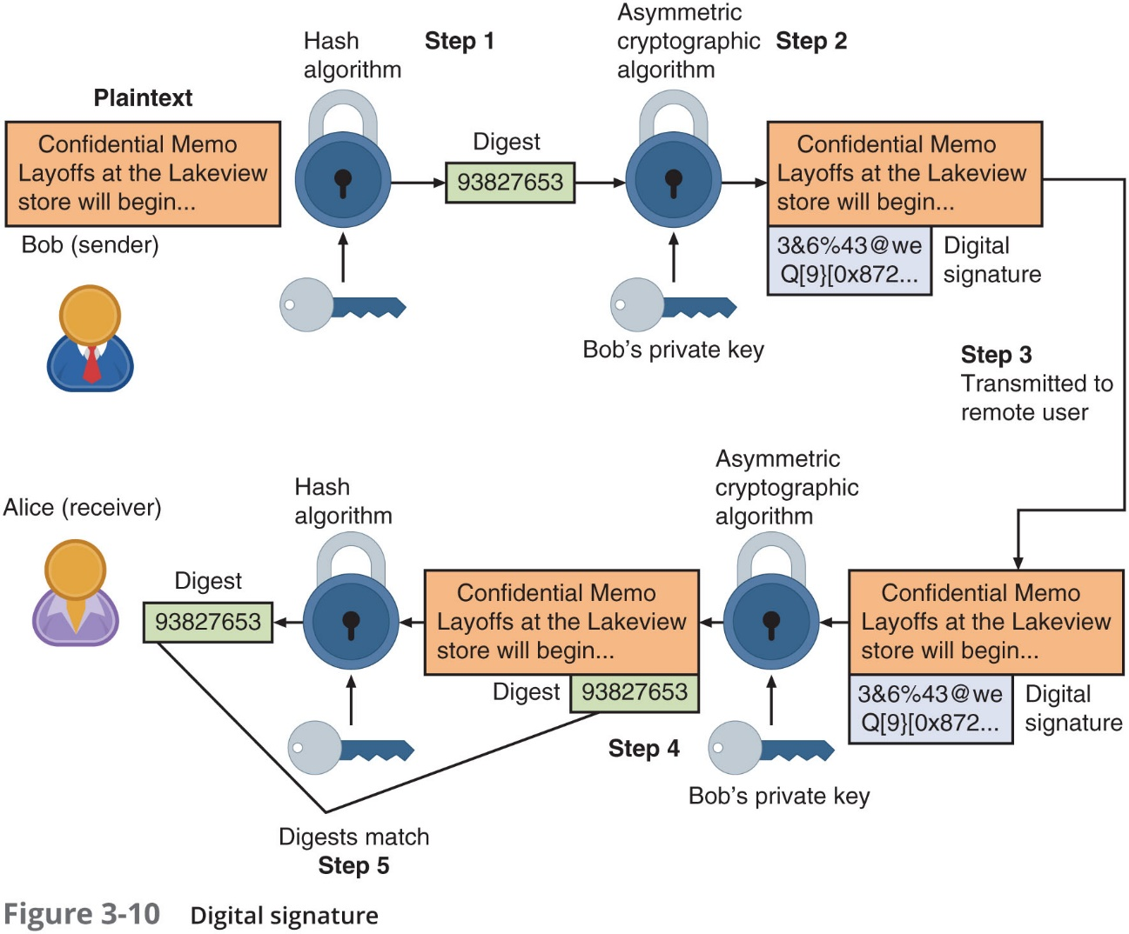
Asymmetric Cryptographic Algorithms (7 of 8)

Slide 34
Asymmetric Cryptographic Algorithms (8 of 8)
Key Exchange
There are different solutions for a key exchange that occurs within the normal communications channel (in-band) of cryptography:
Diffie-Hellman (D H)
Diffie-Hellman Ephemeral (D H E)
Elliptic Curve Diffie-Hellman (E C D H)
Perfect forward secrecy

Slide 35
Cryptographic Attacks
Several of the more common cryptographic attacks include those that:
Target algorithm weaknesses
Exploit collisions

Slide 36
Algorithm Attacks (1 of 3)
Methods attackers can focus on circumventing strong algorithms:
Known ciphertext attacks
Downgrade attacks
Using deprecated algorithms
Taking advantage of improperly implemented algorithms

Slide 37
Algorithm Attacks (2 of 3)
Known Ciphertext Attack
Statistical tools can be used to attempt to discover a pattern in the ciphertexts, which can then be used to reveal the plaintext or key
Statistic | Example | How Used
Underlying language of plaintext | English | By knowing which language is used for the plaintext message inferences can be made regarding statistical values of that language
Distribution of characters | In English E is most commonly used letter, Q is least commonly used | Patterns can emerge when more common letters are used more frequently
Null ciphertexts | Distinguishing between actual ciphertexts and injected null messages | Attacks may inject a frame that contains null values to compare it with the frames containing ciphertext
Management frames | Analyze content of network management information | Because network management frames typically contain information that remains constant this can help establish patterns

Slide 38
Algorithm Attacks (3 of 3)
Downgrade Attack
A threat actor forces the system to abandon the current higher security mode of operation and instead “fall back” to implementing an older and less secure mode
Using Deprecated Algorithms
Means to use a cryptographic algorithm that should not be used because of known vulnerabilities
Improper Implementation
Known as misconfiguration implementation
Many cryptographic algorithms have several configuration options
Unless careful consideration is given to these options the cryptography may be improperly implemented

Slide 39
Collision Attacks
When two files have the same hash this is known as a collision
Collision attack
An attempt to find two input strings of a hash function that produce the same hash result
Birthday attack
Based on the birthday paradox, which says that for there to be a 50 percent chance that someone in a given room shares your birthday, 253 people would need to be in the room

Slide 40
Using Cryptography
Cryptography should be used to secure:
Data-in-transit, data-at-rest, and when possible data-in-use
This includes:
Individual files
Databases
Removable media
Data on mobile devices
Cryptography can be applied through:
Software
Hardware

Slide 41
Encryption Through Software (1 of 2)
File and File System Cryptography
Encryption software can be used to encrypt or decrypt files one-by-one
Pretty Good Privacy (P G P)
Widely used asymmetric cryptography system
Used for files and e-mails on Windows systems
G N U Privacy Guard (G NuP G)
Open-source product that runs on Windows, UNIX, and Linux operating systems
Open P G P is another open-source alternative that is based on P G P

Slide 42
Encryption Through Software (2 of 2)
Operating System Encryption
Microsoft Windows Encrypting File System (E F S)
Cryptography system for Windows
Uses N T F S file system
Tightly integrated with the file system
Encryption and decryption are transparent to the user
Full Disk Encryption (F D E)
Protects all data on a hard drive
Example: BitLocker drive encryption software that is included in Microsoft Windows
BitLocker encrypts the entire system volume, including the Windows Registry
Prevents attackers from accessing data by booting from another O S or placing the hard drive in another computer

Slide 43
Hardware Encryption (1 of 4)
Software encryption can be subject to attacks to exploit its vulnerabilities
Cryptography can be embedded in hardware
Provides higher degree of security
Can be applied to U S B devices and standard hard drives
Hardware encryption options include:
Trusted platform module
Hardware security model

Slide 44
Hardware Encryption (2 of 4)
U S B device encryption
Encrypted hardware-based flash drives can be used
Will not connect a computer until correct password has been provided
All data copied to the drive is automatically encrypted
Tamper-resistant external cases
Administrators can remotely control and track activity on the devices
Stolen drives can be remotely disabled
Self-Encrypting Drives (S E Ds)
Self-encrypting hard disk drives protect all files stored on them
The drive and host device perform authentication process during initial power up
If authentication fails, the drive can be configured to deny access or even delete encryption keys so all data is permanently unreadable

Slide 45
Hardware Encryption (3 of 4)
Trusted Platform Module (T P M)
A chip on a computer’s motherboard that provides cryptographic services
Includes a true random number generator
Entirely done in hardware so it cannot be subject to software attack
Prevents computer from booting if files or data have been altered
Prompts for password if hard drive moved to a new computer

Slide 46
Hardware Encryption (4 of 4)
Hardware Security Module (H S M)
A secure cryptographic processor
Includes an onboard key generator and key storage facility
Performs accelerated symmetric and asymmetric encryption
Can provide services to multiple devices over a LAN

Slide 47
Review Questions
What is the latest version of the Secure Hash Algorithm?
A. SHA-2
B. SHA-3
C. SHA-4
D. SHA-5
Which of the following key exchanges uses the same keys each time?
A. Diffie-Hellman-RSA (DHRSA)
B. Diffie-Hellman Ephemeral (DHE)
C. Diffie-Hellman (DH)
D. Elliptic Curve Diffie-Hellman (ECDH)
Proving that a user sent an email message is known as _____.
A. non-repudiation
B. repudiation
C. integrity
D. availability

Slide 48
Chapter Summary (1 of 2)
Cryptography is the practice of transforming information into a secure form while being transmitted or stored
The strength of a cryptographic algorithm depends upon several factors
Cryptography can provide confidentiality, integrity, authentication, non-repudiation, and obfuscation
Hashing creates a unique digital fingerprint that represents contents of original material
Used only for comparison
Symmetric cryptography uses a single key to encrypt and decrypt a message
Stream ciphers and block ciphers

Slide 49
Chapter Summary (2 of 2)
Asymmetric cryptography
Public key cryptography
Uses two keys: public key and private key
Cryptography can be applied through hardware or software
Hardware encryption cannot be exploited like software cryptography

